Slide 1
MGS 425 (S1S) Management of it projects
Week 5 – March 1st

Slide 2
Agenda
Chapter 9 – Product Owner.
Chapter 10 – ScrumMaster.
TopHat assignment based on material from this week.

Slide 3
Product Owner
Chapter 9

Slide 4
Product Owner – Overview
Chapter Agenda
Description of the product owner role.
Purpose of this role relative to other Scrum roles.
Principal responsibilities and characteristics of a product owner.
A “day in the life” of a PO over the course of multiple weeks.
Who should be a product owner for different types of product development.
Describe how the product owner role can be combined with other roles and how it can be scaled up into a product owner team.

Slide 5
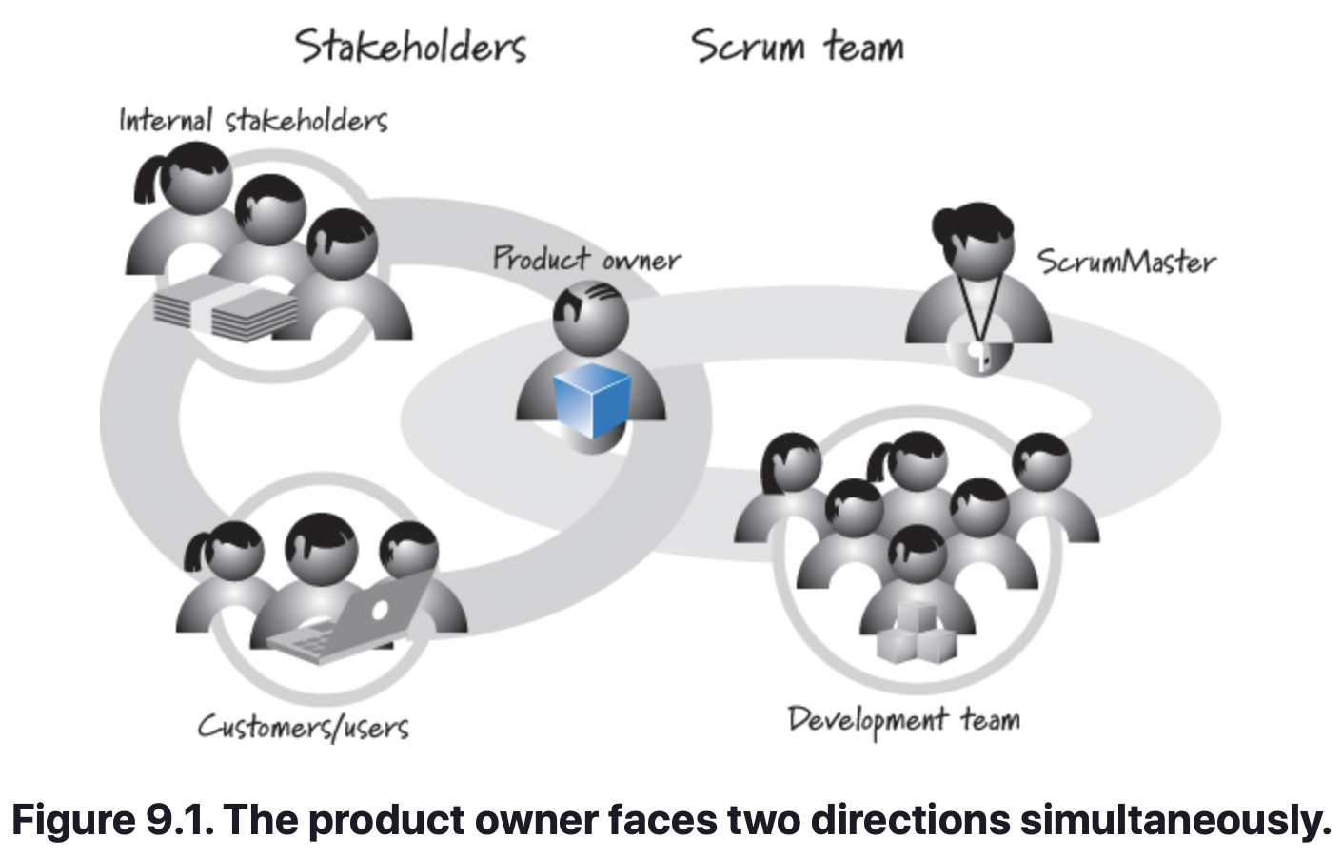
Product Owner – Overview
Chapter Summary
The product owner is the empowered central point of product leadership. It is one of the three collaborating roles that constitute every Scrum team (the others being the ScrumMaster and the development team).
The product owner needs to look in at least two directions simultaneously (see Figure 9.1).
On one hand, the product owner must understand the needs and priorities of the organizational stakeholders, the customers, and the users.
On the other hand, the product owner must communicate to the development team what to build and the order in which to build it.

Slide 6
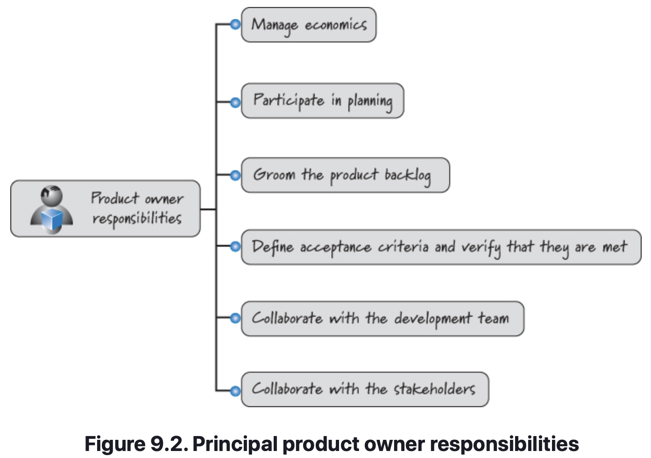
Product Owner – Principal Responsibilities
Figure 9.2 illustrates the principal product owner responsibilities, which is a full-time role with significant oversight. In most cases a single person can and should fill the product owner role; however, under certain circumstances, product owner teams or product owner proxies might be practical.

Slide 7
Product Owner – Principal Responsibilities
Manage Economics
The product owner is responsible for ensuring that good economic decisions are continuously being made at the release, sprint, and product backlog levels.
Release-Level Economics
At the release level the product owner continuously makes trade-offs in scope, date, budget, and quality as a stream of economically important information arrives during product development.
Trade-offs made at the beginning of a release might no longer be appropriate in the presence of new information that arrives during the release.
Also, at the end of every sprint the product owner oversees a decision as to whether or not to fund the next sprint.

Slide 8
Product Owner – Principal Responsibilities
Manage Economics
Sprint-Level Economics
In addition to release-level economics, the product owner also manages sprint-level economics, ensuring that a good return on investment (ROI) is delivered from each sprint.
Good product owners treat their organization’s money as if it were their own money. In most cases the product owner knows the cost of the next sprint (the duration and team composition of the sprint are known).
Product Backlog Economics
The product owner is responsible for prioritizing the product backlog. When economic conditions change, the priorities in the product backlog will likely change as well.

Slide 9
Product Owner – Principal Responsibilities
Participate in Planning
The product owner is a key participant in the portfolio-, product-, release-, and sprint-planning activities.
During portfolio planning, the product owner works with internal stakeholders to position the product correctly in the portfolio backlog and to determine when to start and end product development.
During product planning, the product owner works with the stakeholders to envision the product.
During release planning, the product owner works with the stakeholders and the team to define the content of the next release.
During sprint planning, the product owner works with the development team to define a sprint goal and provides valuable input that enables the development team to select a set of product backlog items that the team can realistically deliver by the end of the sprint.

Slide 10
Product Owner – Principal Responsibilities
Groom the Product Backlog
The product owner oversees the grooming of the product backlog, which includes creating and refining, estimating, and prioritizing product backlog items.
The product owner doesn’t personally perform all of the grooming work. For example, he might not write all of the product backlog items; others might contribute them.
The product owner also doesn’t estimate the items (the development team does that) but is available for questions and clarification during estimation.
The product owner is, however, ultimately responsible for making sure that the grooming activities take place in a way that promotes the smooth flow of delivered value.

Slide 11
Product Owner – Principal Responsibilities
Define Acceptance Criteria and Verify That They Are Met
The product owner is responsible for defining the acceptance criteria for each product backlog item. These are the conditions under which the product owner would be satisfied that the functional and nonfunctional requirements have been met.
The product owner may also write acceptance tests corresponding to the acceptance criteria, or he could enlist the assistance of subject matter experts (SMEs) or development team members.
The product owner is ultimately responsible for confirming that the acceptance criteria are met.
It is important for the product owner to verify acceptance criteria during sprint execution rather than waiting until the sprint review. By doing some testing as the features are completed, the product owner can identify mistakes and misunderstandings that the team can fix before the sprint review.

Slide 12
Product Owner – Principal Responsibilities
Collaborate with the Development Team
The product owner must closely collaborate with the development team on a frequent basis.
The product owner is an engaged, committed, everyday role.
Many organizations just starting to adopt Scrum fail to foster adequate product owner engagement with the development team, delaying essential feedback and substantially reducing the value of that feedback when it does occur.
Using traditional, phase-based development, customers have considerable up-front involvement to help define the complete set of requirements.
Once the effort transitions into more technical phases (such as design, coding, and certain types of testing), the customers are “no longer needed.”
Unfortunately, in this scenario, the customer is first exposed to hands-on experience with the system at the end of development – far too late to make any meaningful changes.

Slide 13
Product Owner – Principal Responsibilities
Collaborate with Stakeholders
The product owner is the single voice of the entire stakeholder community, internal and external.
Internal stakeholders can include business systems owners, executive management, program management, marketing, and sales.
External stakeholders can include customers, users, partners, regulatory bodies, and others.
The product owner must work closely with the entire stakeholder community to gather input and synthesize a coherent vision to guide product development.
This role is typically filled by one person, but there are ways to share responsibilities that will be discussed later.

Slide 14
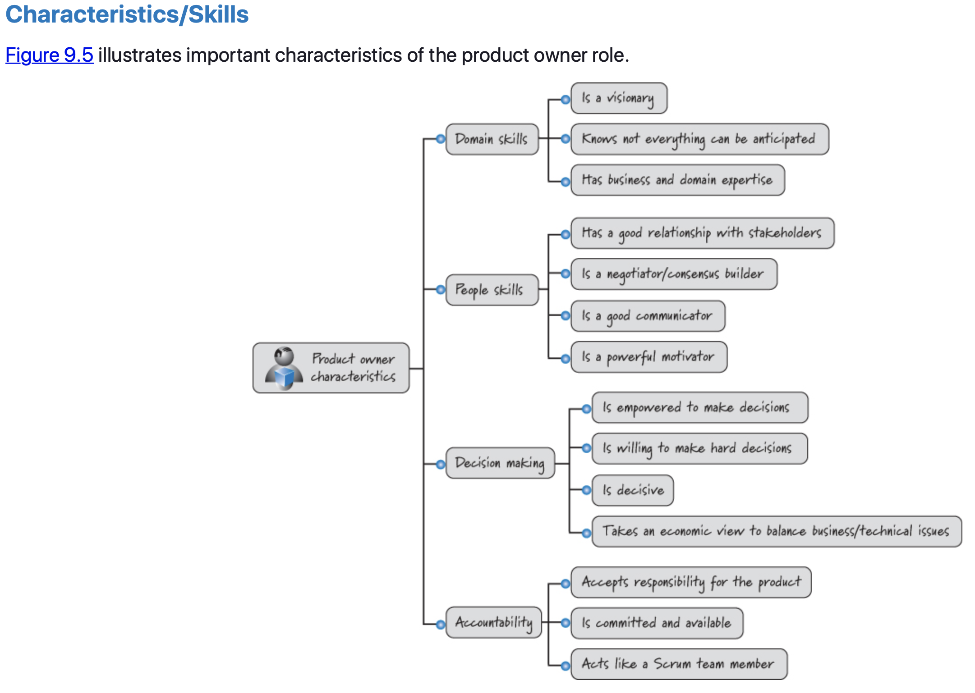
Product Owner – Principal Responsibilities

Slide 15
Product Owner – Principal Responsibilities
PO Characteristics and Skills
Domain Skills
Visionary.
Appreciates that not everything can be anticipated.
Has business and domain experience.

Slide 16
Product Owner – Principal Responsibilities
PO Characteristics and Skills
People Skills
Maintains a good relationship with stakeholders.
Negotiates and leads by building consensus.
Excellent at all forms of communication.
Great at motivating others.

Slide 17
Product Owner – Principal Responsibilities
PO Characteristics and Skills
Decision Making
Empowered to make decisions.
Willing to make difficult decisions.
Is decisive.
Able to economically balance technical and issues.

Slide 18
Product Owner – Principal Responsibilities
PO Characteristics and Skills
Accountability
Accepts responsibility for all aspects of the product.
Is fully committed and available.
Acts like a Scrum team member.

Slide 19
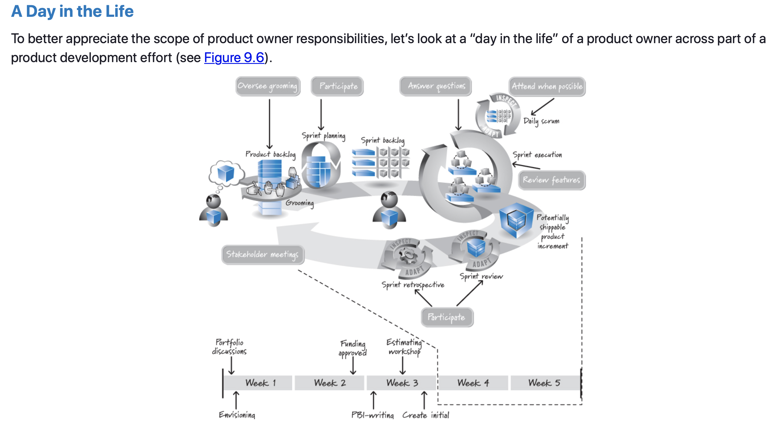
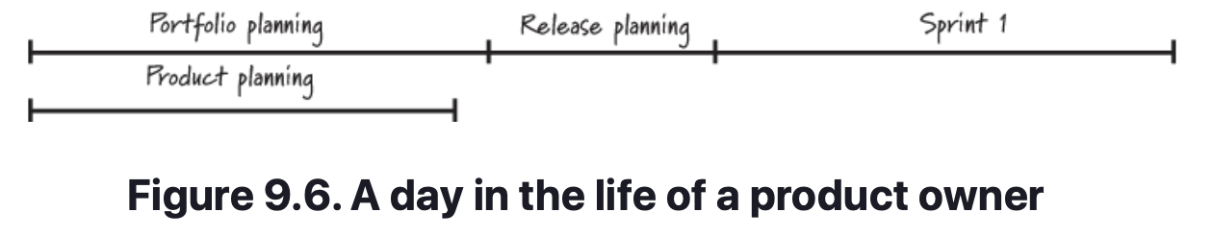
Product Owner – A Day in the Life of a PO

Slide 20
Product Owner – A Day in the Life of a PO
Critical Behaviors for Success
The product owner facilitates an initial release-planning session (longer-term planning).
During sprint execution, the product owner tries to attend the team’s daily scrums; this may not always be possible, but it is a good practice.
During the daily scrum, the product owner listens to better understand how the current sprint is progressing and to identify opportunities to assist the development team.
The product owner must also be available (typically every day) to answer questions and to test features as they become reviewable.
Also during sprint execution the product owner meets with both the internal and external stakeholders to ensure that priorities for the upcoming sprint are correct, securing valuable user input that will affect the features chosen for future sprints.

Slide 21
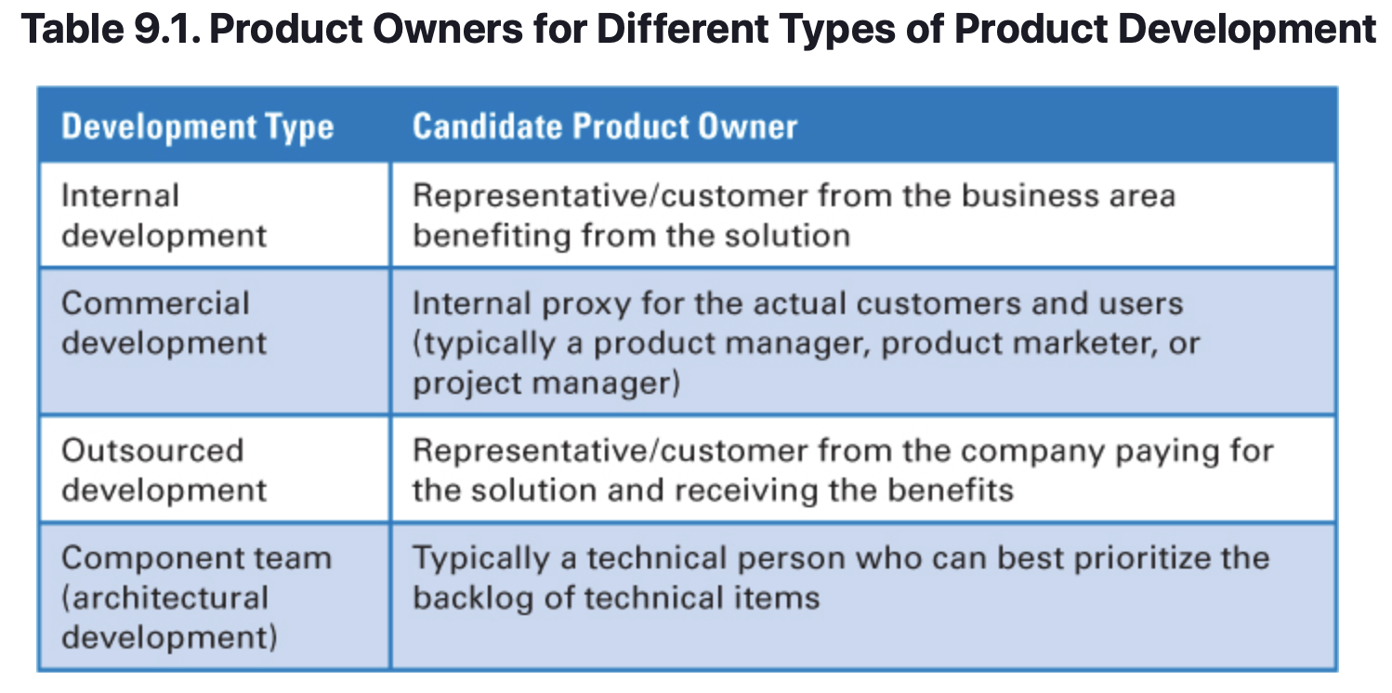
Product Owner – Who Should be a PO?
Most non-Scrum organizations probably won’t have an existing role labeled “product owner.” So, who within the organization should fill the product owner role?
Exactly who should be the product owner depends on the type of development effort and the specific organization. Table 9.1 suggests good candidates for the product owner role for different types of development.

Slide 22
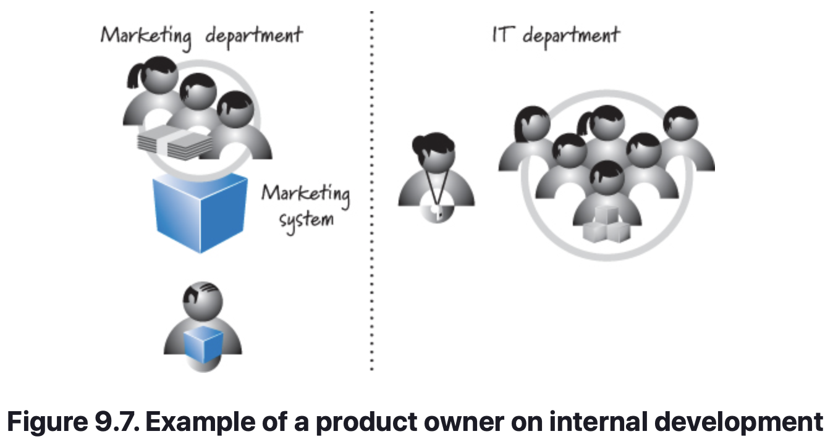
Product Owner – Who Should be a PO?
Internal Development
On an internal development effort, an empowered person from the group that will benefit from the development should be the product owner. For example, if an internal IT group develops a system for the marketing group, an empowered person from the marketing team should be the product owner (see Figure 9.7).
Notes:
Some organizations (typically those that haven’t yet learned the importance of having a business person as the day-to-day engaged product owner) might ask an IT person to handle the day-to-day product owner responsibilities. I will review the issues with this approach when I discuss the concept of a product owner team later in this chapter.

Slide 23
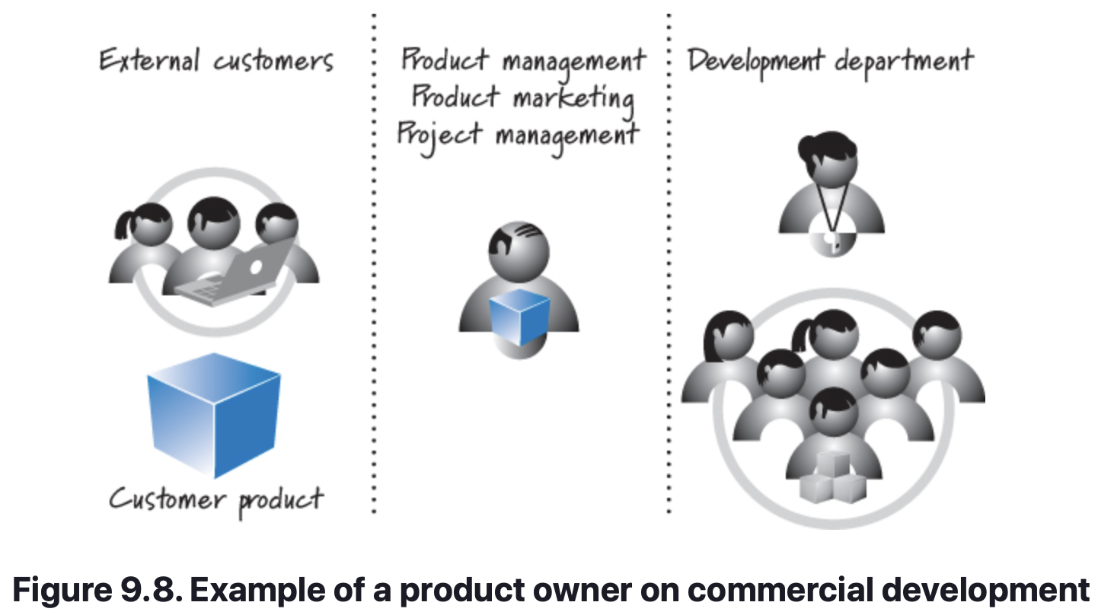
Product Owner – Who Should be a PO?
Commercial Development
On a commercial development effort—for example, a company building a product for sale to external customers—the product owner should be an organization employee who acts as the voice of the actual customers. Frequently this person comes from the ranks of product management or product marketing (see Figure 9.8).
Notes:
Scrum practitioners have hotly debated whether or not the product owner role is really just the Scrum (and agile) renaming of the product manager role. Some believe the two roles are synonymous. Others advocate that the product owner role is larger than the product manager role. And, of course, still others argue that the product manager role is larger.

Slide 24
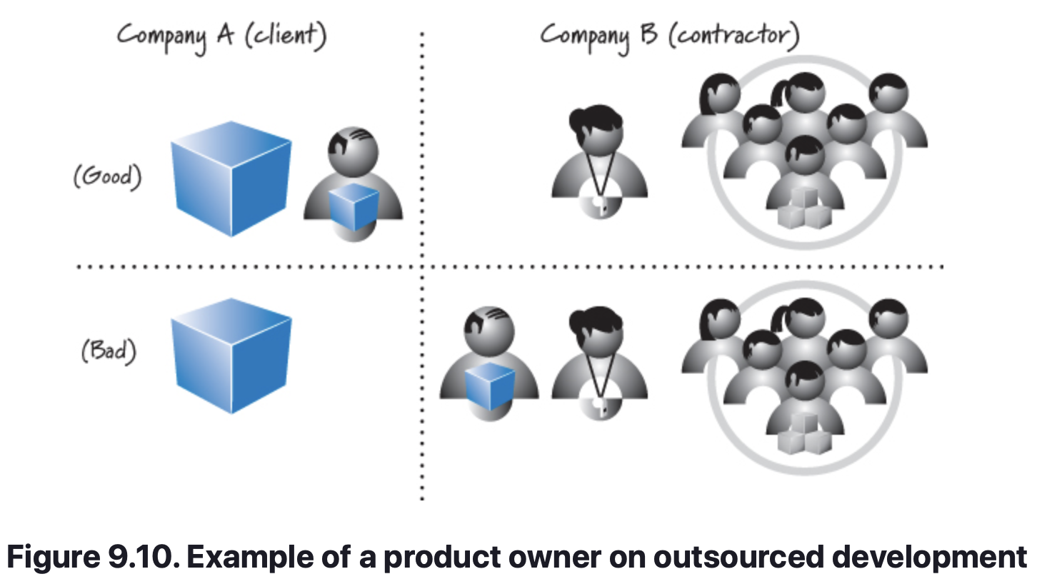
Product Owner – Who Should be a PO?
Outsourced Development Project
On an outsourced development effort—for example, company A contracting with company B to build a solution—a representative from company A should be the product owner. Company B may assign an internal person to closely liaise with the product owner, but the product owner should be from the company that is paying for the solution and receiving the benefits (see Figure 9.10).
Notes:
The product owner role gets complicated if company A and company B enter into a traditional fixed-price development contract. In that case company B will almost certainly feel that it should be fulfilling most of the product owner responsibilities because it has assumed the risk of a fixed-price contract. In reality, though, company A, as the actual customer, should fill the product owner role. A more appropriate contract would have company A leasing the high-performance development team and ScrumMaster from company B and company A providing the product owner.

Slide 25
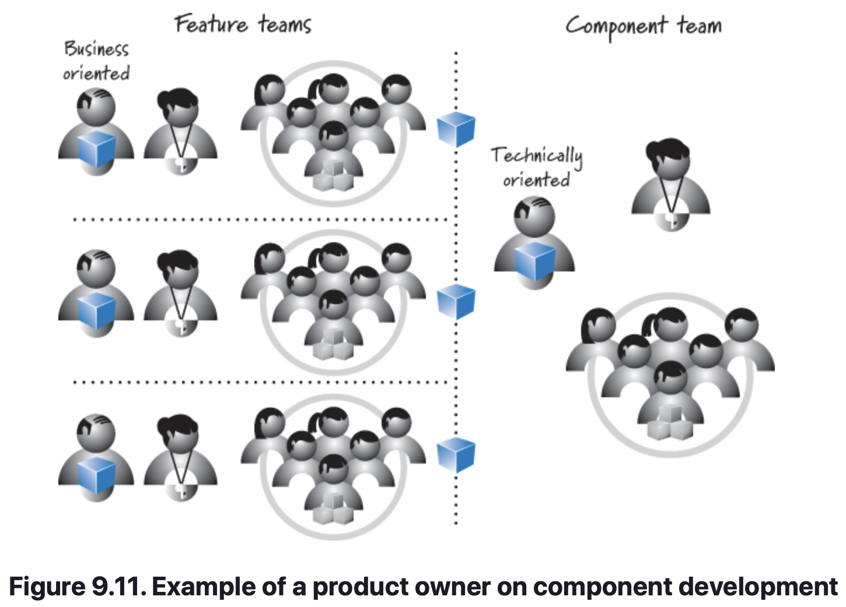
Product Owner – Who Should be a PO?
Component Development
Last, some organizations might use component teams that build parts of customer solutions but not full customer solutions.
These teams tend to create components or other assets that are then reused by other teams to assemble customer-valuable solutions. Because these teams focus at a technical component level, their product owners are typically technically oriented people who are capable of defining and prioritizing the technical features in their backlogs (see Figure 9.11).
Notes:
In the figure, there are three business-oriented feature teams that create features that are valuable to the end users. Each feature team has its own product owner focused on that team’s features. Each of these feature teams also leverages the work of a component team that provides them with an asset necessary to complete their features. The component team needs a product owner who can prioritize and oversee the development of the various component-level requests being made by the feature teams. The component team’s product owner is likely to be more technically oriented than the product owners of the feature teams.

Slide 26
Product Owner – Product Owner Teams
What is a Product Owner Team?
Every Scrum team must have a single person who is identified as the product owner and is the only person empowered and accountable for fulfilling the product owner responsibilities for that Scrum team.
Should we allow a team of people to perform the product owner role? If by team we mean a group of people with shared decision making and accountability, definitely not. To properly apply Scrum, we need one individual to be the product owner, making decisions and acting as the single voice of the stakeholder communities to the Scrum team.
That being said, some organizations might form what they call a “product owner team” because they recognize that, in their circumstances, the product owner cannot do the job without a select group of people to provide input and guidance. In other companies, the workload of being a product owner might be greater than any one full-time person can reasonably perform.

Slide 27
Product Owner – Product Owner Teams
Product Owner Proxy
A product owner proxy is a person enlisted by the product owner to act on his behalf in particular situations. Everyone on the Scrum team knows that the proxy is not the actual product owner, but everyone also knows that the product owner has empowered the proxy to make at least some tactical decisions on his behalf.
Some companies doing internal development ask an IT person (for example, a business analyst or development manager) to be the product owner because the business unit person is too busy with other work.
IT resources are really not empowered to make important final decisions (one of the key responsibilities of any product owner), as a result, organizations that do this have filled the product owner role ineffectively and confusingly.
A better solution is to free up enough of the business unit person’s time to be the true product owner but have the IT person act as the product owner proxy in certain interactions with the team.

Slide 28
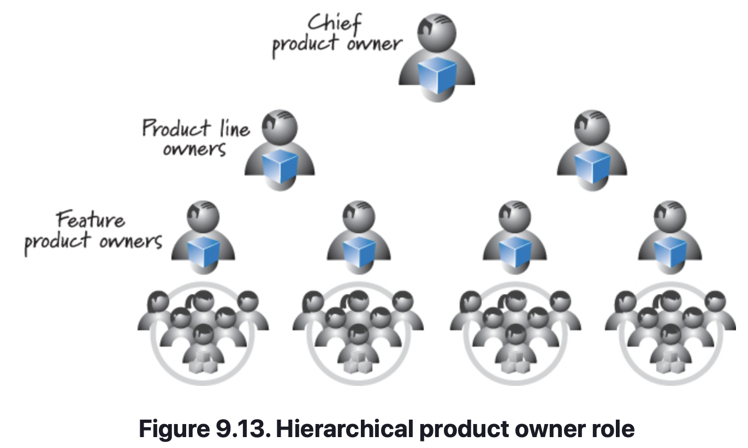
Product Owner – Product Owner Teams
Chief Product Owner
Another situation where a product owner team is frequently created is on very large products.
Ultimately in Figure 9.13 the person labeled chief product owner is the product owner for the whole product. However, the chief product owner has a team of product owners to ensure that the product owner role is filled correctly at each lower level in the hierarchy. Each of the lower level product owners must have appropriate decision-making authority.

Slide 29
Product Owner
Closing
Expanded the description of the product owner role.
Emphasized this role as the empowered central point of product leadership and described important responsibilities and characteristics of the role.
Described what the product owner does during the various Scrum activities on a project.
Discussed what type of person should fill the role for different project types.
Described how a single person might be the product owner for more than one Scrum team, and how on occasion a single person might be both a product owner and a team member on the same Scrum team.
Discussed the idea of a product owner team with a focus on product owner proxies and chief product owners.

Slide 30
Scrummaster
Chapter 10

Slide 31
ScrumMaster – Overview
Chapter Agenda
Principal Responsibilities
Characteristics/Skills
A Day in the Life
Fulfilling the Role
Closing

Slide 32
ScrumMaster – Overview
Chapter Summary
The ScrumMaster is one of three roles on a Scrum team.
While the product owner is focused on building the right product and the development team is focused on building the product right, the ScrumMaster is focused on helping everyone understand and embrace the Scrum values, principles, and practices.
The ScrumMaster acts as a coach to both the development team and the product owner.
A ScrumMaster also provides process leadership, helping the Scrum team and the rest of the organization develop their own high-performance, organization-specific Scrum approach.

Slide 33
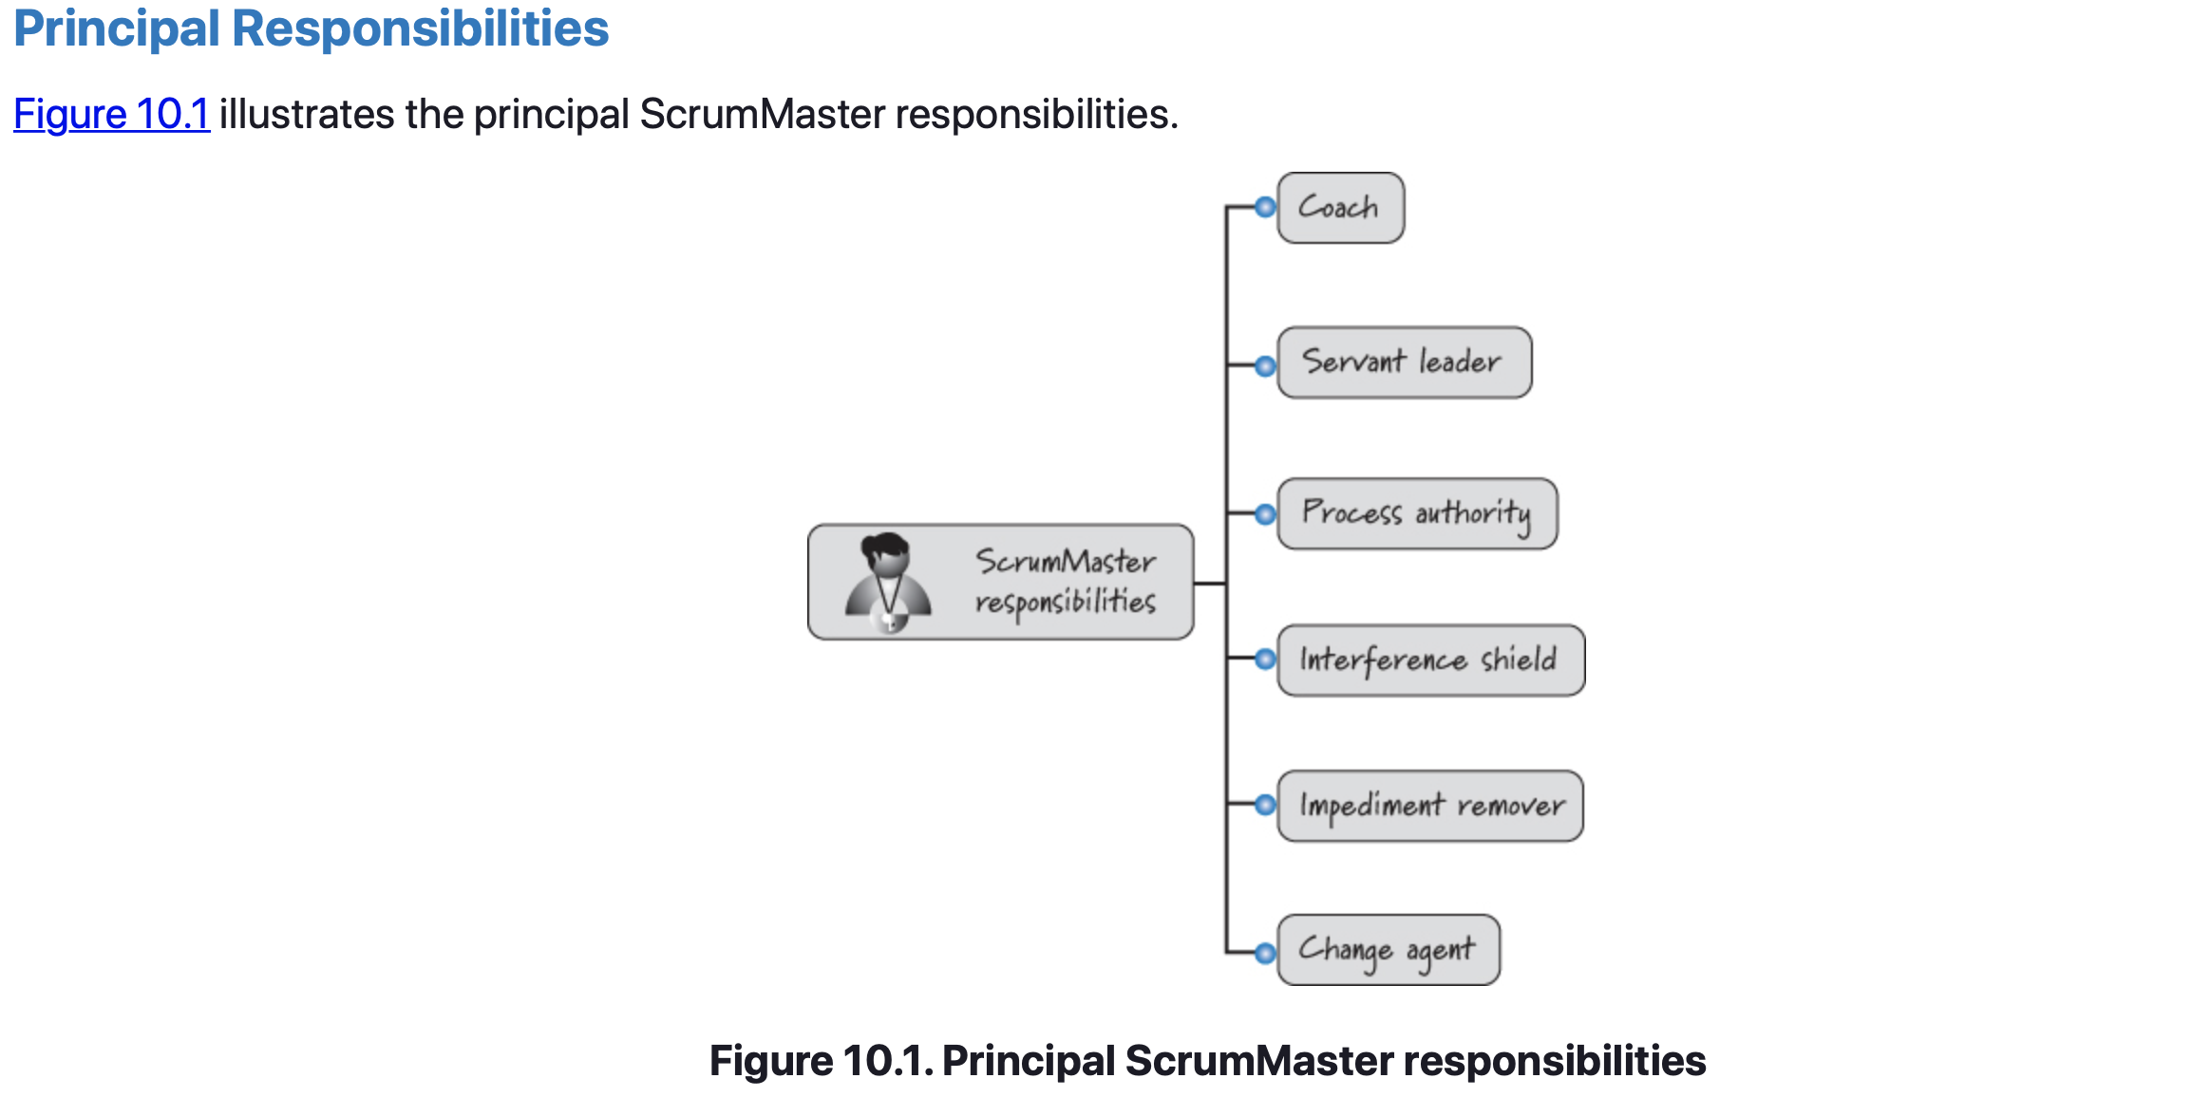
ScrumMaster – Principal Responsibilities

Slide 34
ScrumMaster – Principal Responsibilities
Coach
The ScrumMaster is the agile coach for the Scrum team—both the development team and the product owner.
By coaching both roles, the ScrumMaster can remove barriers between the roles and enable the product owner to directly drive development.
Analogous to the coach of a sports team, the ScrumMaster observes how the team is using Scrum and does anything possible to help it get to the next level of performance.
When problems arise that the team can and should be able to solve, the ScrumMaster’s attitude, like that of any good coach, is “I’m not here to solve your problems for you; instead, I’m here to help you solve your own problems.” If the problem is an impediment that the team can’t resolve, the ScrumMaster takes ownership of getting it resolved.
Notes:
The ScrumMaster coaches a new product owner by helping him understand and perform his product owner responsibilities. Once the ScrumMaster helps the product owner get established in his role, she provides him with ongoing assistance for activities such as grooming the product backlog. Furthermore, in keeping with the sports team analogy, the ScrumMaster’s relationship with the product owner is very much like a sports team coach’s main role with the team’s owner: help the owner maximize business outcomes using Scrum, manage expectations, make sure the owner is providing the team with what it needs, and listen to the owner’s complaints and requests for change and translate those into actionable improvements for the team.

Slide 35
ScrumMaster – Principal Responsibilities
Servant Leader
The ScrumMaster is often described as a servant leader of the Scrum team.
Even when acting as the team’s coach, the ScrumMaster is first and foremost a servant to the Scrum team, ensuring that its highest-priority needs are being met.
A servant leader would never ask, “So, what are you going to do for me today?” Instead, a servant leader asks, “So, what can I do today to help you and the team be more effective?”

Slide 36
ScrumMaster – Principal Responsibilities
Process Authority
The ScrumMaster is the Scrum team’s process authority.
In this capacity, the ScrumMaster is empowered to ensure that the Scrum team enacts and adheres to the Scrum values, principles, and practices along with the Scrum team’s specific approaches.
The ScrumMaster continuously helps the Scrum team improve the process, whenever possible, to maximize delivered business value.
Authority in this context is not the same type of authority that a functional manager or project manager would have. For example, the ScrumMaster doesn’t hire and fire and cannot dictate to the team what tasks it should do or how to do them. The ScrumMaster also is not responsible for making sure the work gets done.
Instead, the ScrumMaster helps the team define and adhere to its own process for making sure the work gets done.

Slide 37
ScrumMaster – Principal Responsibilities
Interference Shield
The ScrumMaster protects the development team from outside interference so that it can remain focused on delivering business value every sprint.
Interference can come from any number of sources, from managers who want to redirect team members in the middle of a sprint, to issues originating from other teams.
No matter what the source of the interference, the ScrumMaster acts as an interceptor (fielding inquiries, addressing management, and arbitrating disputes) so that the team can focus on delivering value.

Slide 38
ScrumMaster – Principal Responsibilities
Impediment Remover
The ScrumMaster also takes responsibility for removing impediments that inhibit the team’s productivity (when the team members themselves cannot reasonably remove them).
For example, imagine if a Scrum team that was consistently unable to meet its sprint goals.
The impediment was unstable production servers that the team used during testing (as part of its definition of done).
The team itself had no control over these servers—that was the responsibility of the VP of Operations. Because the team itself could not remove the impediment, the ScrumMaster took ownership of improving the server stability by working with the VP of Operations and others who could actually do something about the stability issue.

Slide 39
ScrumMaster – Principal Responsibilities
Change Agent
The ScrumMaster must help change more than faulty servers and similar impediments.
A good ScrumMaster must help change minds as well. Scrum can be very disruptive to the status quo; the change that is required to be successful with Scrum can be difficult.
The ScrumMaster helps others understand the need for change, the impacts of Scrum outside of the Scrum team, and the broad-reaching benefits Scrum can help achieve.
The ScrumMaster also ensures that effective change is occurring at all levels of the organization, enabling not only short-term success but, more importantly, the long-term benefits from using Scrum.
In large organizations, the ScrumMasters might band together to become a more effective force for change.

Slide 40
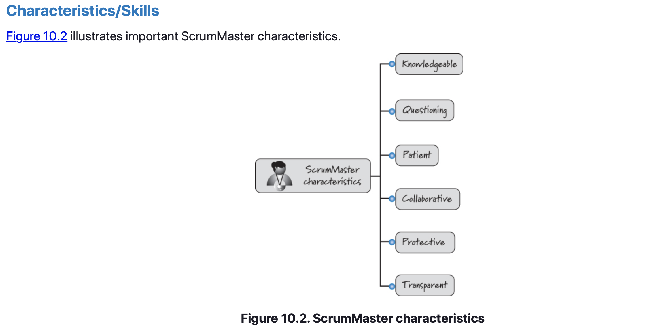
ScrumMaster – Characteristics and Skills

Slide 41
ScrumMaster – Characteristics and Skills
Knowledgeable
To be an effective process coach, the ScrumMaster must be very knowledgeable about Scrum.
The ScrumMaster should also understand the technical issues the team needs to address and technologies the team will use to create solutions.
A ScrumMaster doesn’t need to have tech-lead- or dev-lead-level knowledge, but reasonable technical knowledge is an asset.
The ScrumMaster also doesn’t need to be an expert in the business domain (the product owner does), but again, working knowledge of the business domain is very helpful.

Slide 42
ScrumMaster – Characteristics and Skills
Questioning
ScrumMasters use their coaching skills in conjunction with their process, technical, and business knowledge to ask great questions.
They engage in intentional inquiry, asking the kinds of questions that make people stop and say, “Hmm. I never thought about that. Now that you ask that question, it makes me think there might be another way to go.”
Great ScrumMasters almost never directly answer a question but instead reflexively answer with their own question—not an annoying question, or a question for the sake of asking a question, but rather a thoughtful, deep, probing question—thereby helping people realize that they have the insight to find their own answers (a form of Socratic questioning).
Notes:
Socratic Questioning
Questions of Clarification
• What is your main point?
• Can you give me an example?
• What is the source of that idea or information?
• Can you summarise what we discussed?
Questions that Probe Assumptions
• What are you assuming?
• How would you support your assumptions?
Questions that Probe Reasons and Evidence
• What did you observe in the demonstration / experiment?
• What evidence supports your hypothesis?
Questions that Probe Implications and Consequences
• What effect would that have?
• What could you generalise from this observation?
• What does that remind you of?
• What do you predict will happen next?

Slide 43
ScrumMaster – Characteristics and Skills
Patience
Because ScrumMasters prefer not to give out answers, they need to be patient, giving teams time to arrive at appropriate answers on their own.
At times it is hard for me to be a ScrumMaster because I see the issue the team is dealing with and I “know” the answer. Well, at least I think I know the answer!
It is arrogant for me (or any ScrumMaster) to believe that I am smarter than the collective intelligence of the team. So, at times I just have to bite my tongue and be patient, letting the team work out the solution, periodically asking probing questions to help guide things along.

Slide 44
ScrumMaster – Characteristics and Skills
Collaborative
The ScrumMaster must have excellent collaboration skills to work with the product owner, development team, and all the other parties, even those who might not be directly involved with Scrum.
Also, as the process coach, the ScrumMaster is always looking for opportunities to help the Scrum team members achieve an enviable level of intra-team collaboration.
A ScrumMaster can assist in this effort by personally exhibiting effective collaboration skills.

Slide 45
ScrumMaster – Characteristics and Skills
Protective
The ScrumMaster should be very protective of the team.
The ScrumMaster is adept at ensuring the protection of the team within the greater context of making economically sound business decisions.
With acute sensitivity toward both team protection and business needs, the ScrumMaster helps the Scrum team achieve a healthy balance.
When things get difficult, it is easy for people to fall back on familiar, non-agile approaches.
In this case it is the ScrumMaster’s job to help shepherd straying team members, helping them overcome their difficulties by reinforcing how to use Scrum more effectively.
Notes:
The common analogy is that the ScrumMaster acts like a sheepdog, guarding the flock from wolves that might try to attack. In our context wolves could be organizational impediments or people with differing agendas.

Slide 46
ScrumMaster – Characteristics and Skills
Transparent
Finally, the ScrumMaster is transparent in all forms of communication.
When working with team members, there is no room for hidden agendas; what you see and hear from the ScrumMaster must be what you get.
People expect nothing less of a servant leader. The ScrumMaster also promotes transparent communication outside of the Scrum team.
Without transparent access to information it is difficult for the organization to inspect and adapt to achieve its desired business results from using Scrum.

Slide 47
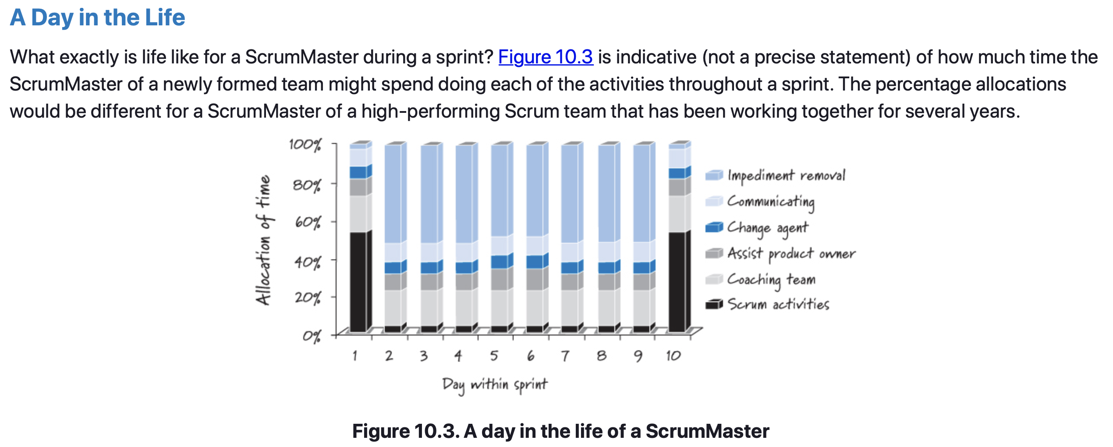
ScrumMaster – A Day in the Life

Slide 48
ScrumMaster – Fulfilling the Role
Who Should be a ScrumMaster?
Organizations new to Scrum won’t have existing people in a role called ScrumMaster.
So where do we find the ScrumMasters? Great ScrumMasters come from many different existing roles.
Some ScrumMasters were previously project managers or product managers (although product managers are more likely to transition into the role of product owner).
Other ScrumMasters come from a development, testing, or other technical background.
As long as an individual has the characteristics discussed earlier and is willing to take on the responsibilities of the role, she can be an effective ScrumMaster.

Slide 49
ScrumMaster – Fulfilling the Role
Who Should be a ScrumMaster?
Some organizations feel that the tech lead or dev lead should be the ScrumMaster. These people in fact might make great ScrumMasters, but they also might not be the best choice for the role.
People who are in a technical leadership position are there for a reason—they are technically very good at what they do. The ScrumMaster role is not one where that level of technical excellence is exploited to its full potential.
Functional area managers or resource managers can also be successful ScrumMasters if they have the skills to do the job.
It would be best if such managers no longer retained people management responsibility, at least not for members of their Scrum teams.
Because a ScrumMaster has no managerial authority, team members might be confused about whether the person is wearing her ScrumMaster or manager hat in a particular instance.

Slide 50
ScrumMaster – Fulfilling the Role
Is ScrumMaster a Full-Time Job?
Every Scrum team has a ScrumMaster, but is it always a full-time role? Possibly not.
A Scrum team that has been working together for an extended period of time and has become highly proficient with Scrum might require less coaching than a new team made up of people who have never worked together and are new to Scrum.
Although the ScrumMaster might need to spend less time with the team day to day as the team matures, the ScrumMaster role remains critical to the success of Scrum within the organization.
Usually as the Scrum team’s need for a ScrumMaster decreases, the need for the ScrumMaster to focus on broader organizational impediments and to be a change agent throughout the organization value chain increases.
In most cases, the ScrumMaster role remains a significant commitment of time. In those cases where it’s not a full-time commitment, some combination of roles may take place.

Slide 51
ScrumMaster – Fulfilling the Role
ScrumMaster Combined with Other Roles
If capacity permits and a single person is both a talented ScrumMaster and development team member, that person may act in both roles.
However, this combination could suffer from a conflict of interest when the person tries to wear both hats. For example, what if the person in the combined roles has important ScrumMaster activities (like removing impediments) to perform and also has critical task-level work to do?
Because both are important, compromising either will reduce the Scrum team’s effectiveness.
Complicating the trade-off is the fact that impediments can occur unpredictably and be very time-consuming to address.
This makes it even harder to predict how much time a ScrumMaster as team member will actually have available to do task-level work.

Slide 52
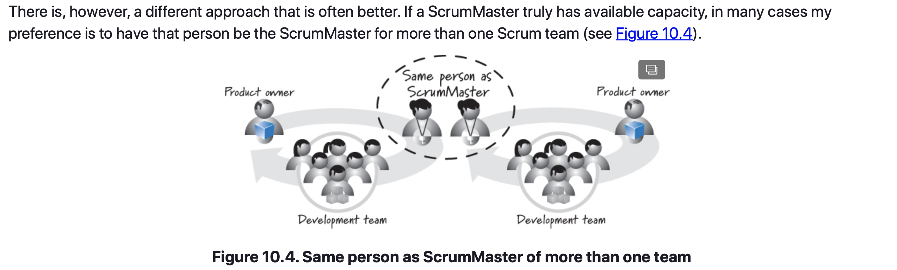
ScrumMaster – Fulfilling the Role
ScrumMaster Combined with Other Roles

Slide 53
ScrumMaster
Closing
Described the ScrumMaster role.
Covered ScrumMaster responsibilities as coach, servant leader, process authority, interference shield, impediment remover, and change agent.
Discussed how the ScrumMaster should be knowledgeable about Scrum, ask great questions, patiently wait for the team to solve its problems, collaborate with everyone, protect the team from undue interference, and communicate in a visible and transparent way.
Described how the ScrumMaster’s time is allocated across a sprint to provide a deeper appreciation for this critical role.
Discussed who within the organization should be the ScrumMaster, whether or not the role is full-time, and how the ScrumMaster role might be combined with other Scrum roles.

Slide 54
Sprints
Sources
Unless otherwise noted, all material in these slides were used from the textbook for this course:
Rubin, Kenneth S., Essential Scrum: A Practical Guide to the Most
Popular Agile Process, 1st Edition. Addison-Wesley Professional; 1st
edition (August 5, 2012). ISBN-13: 978-0137043293.

